Slide 2
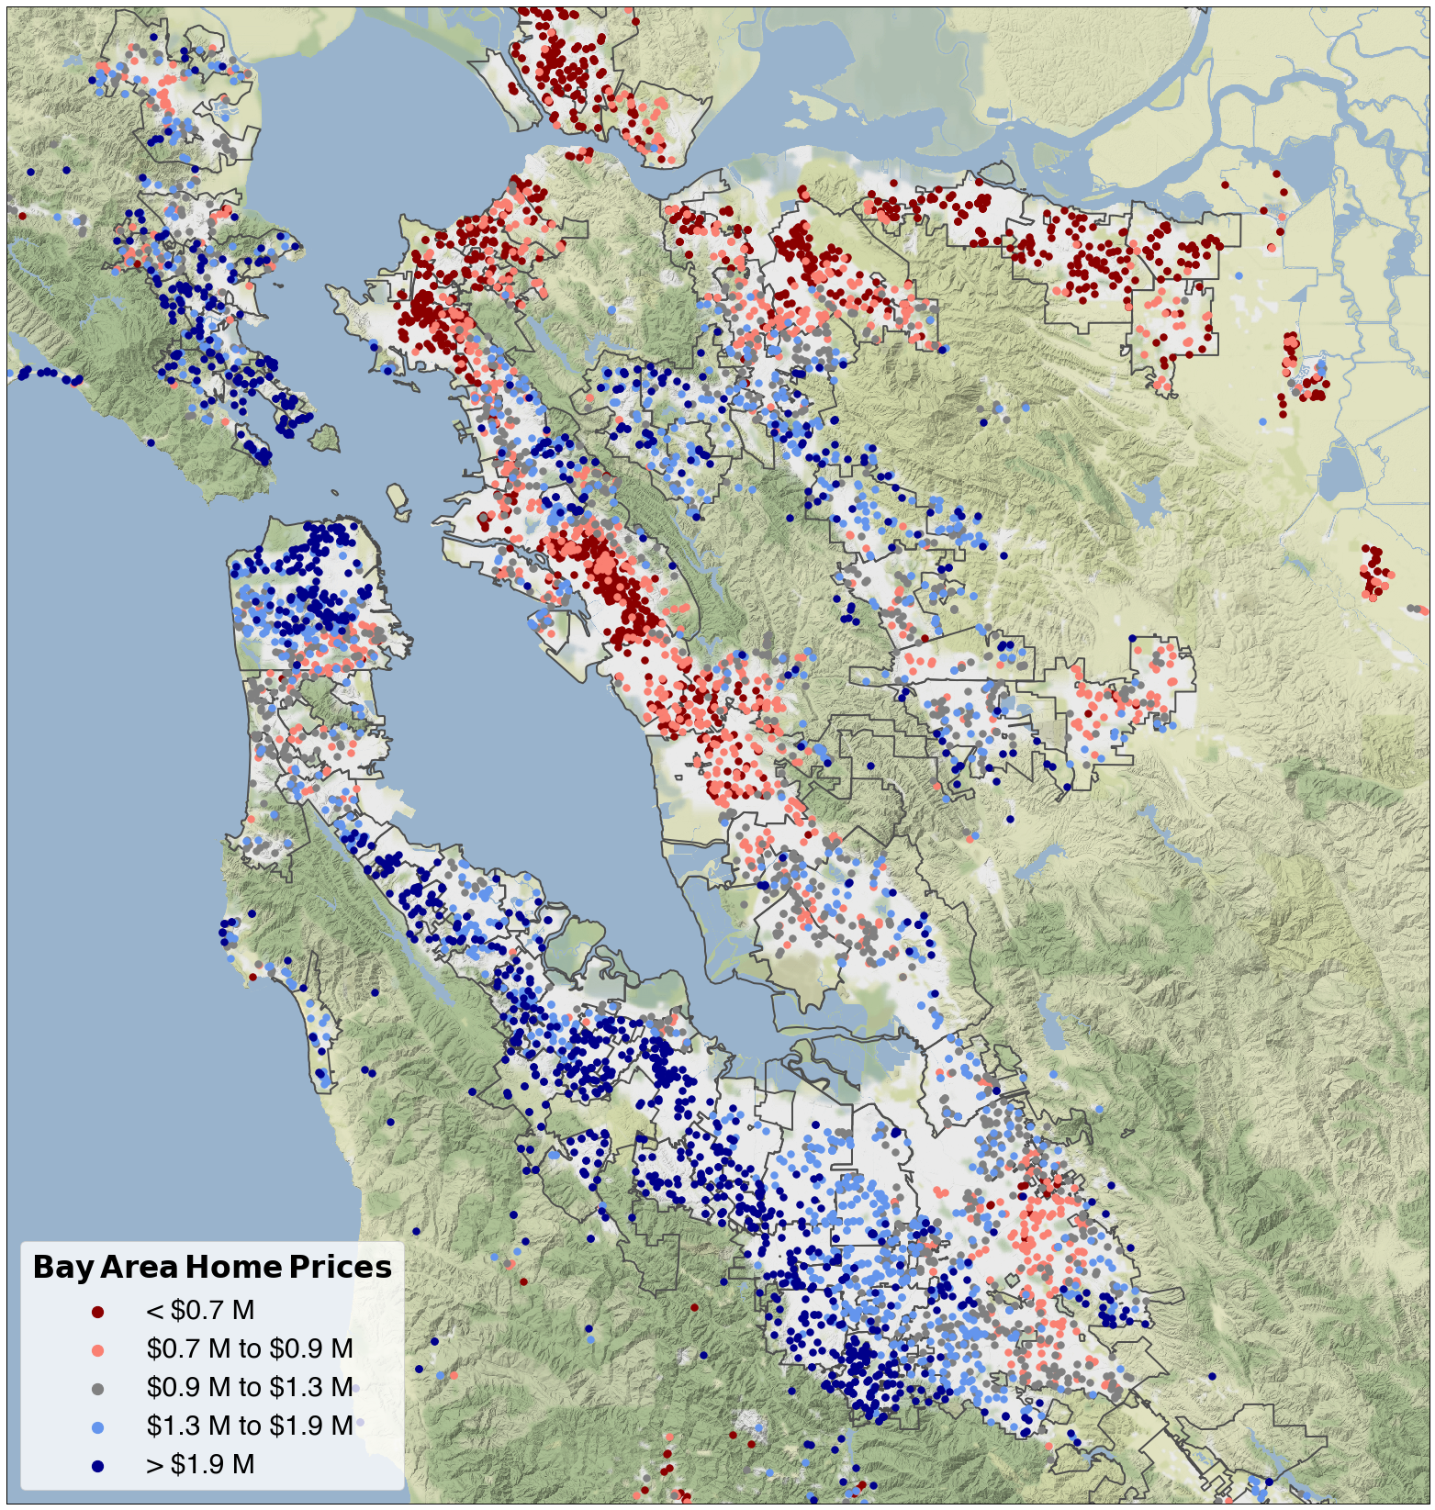
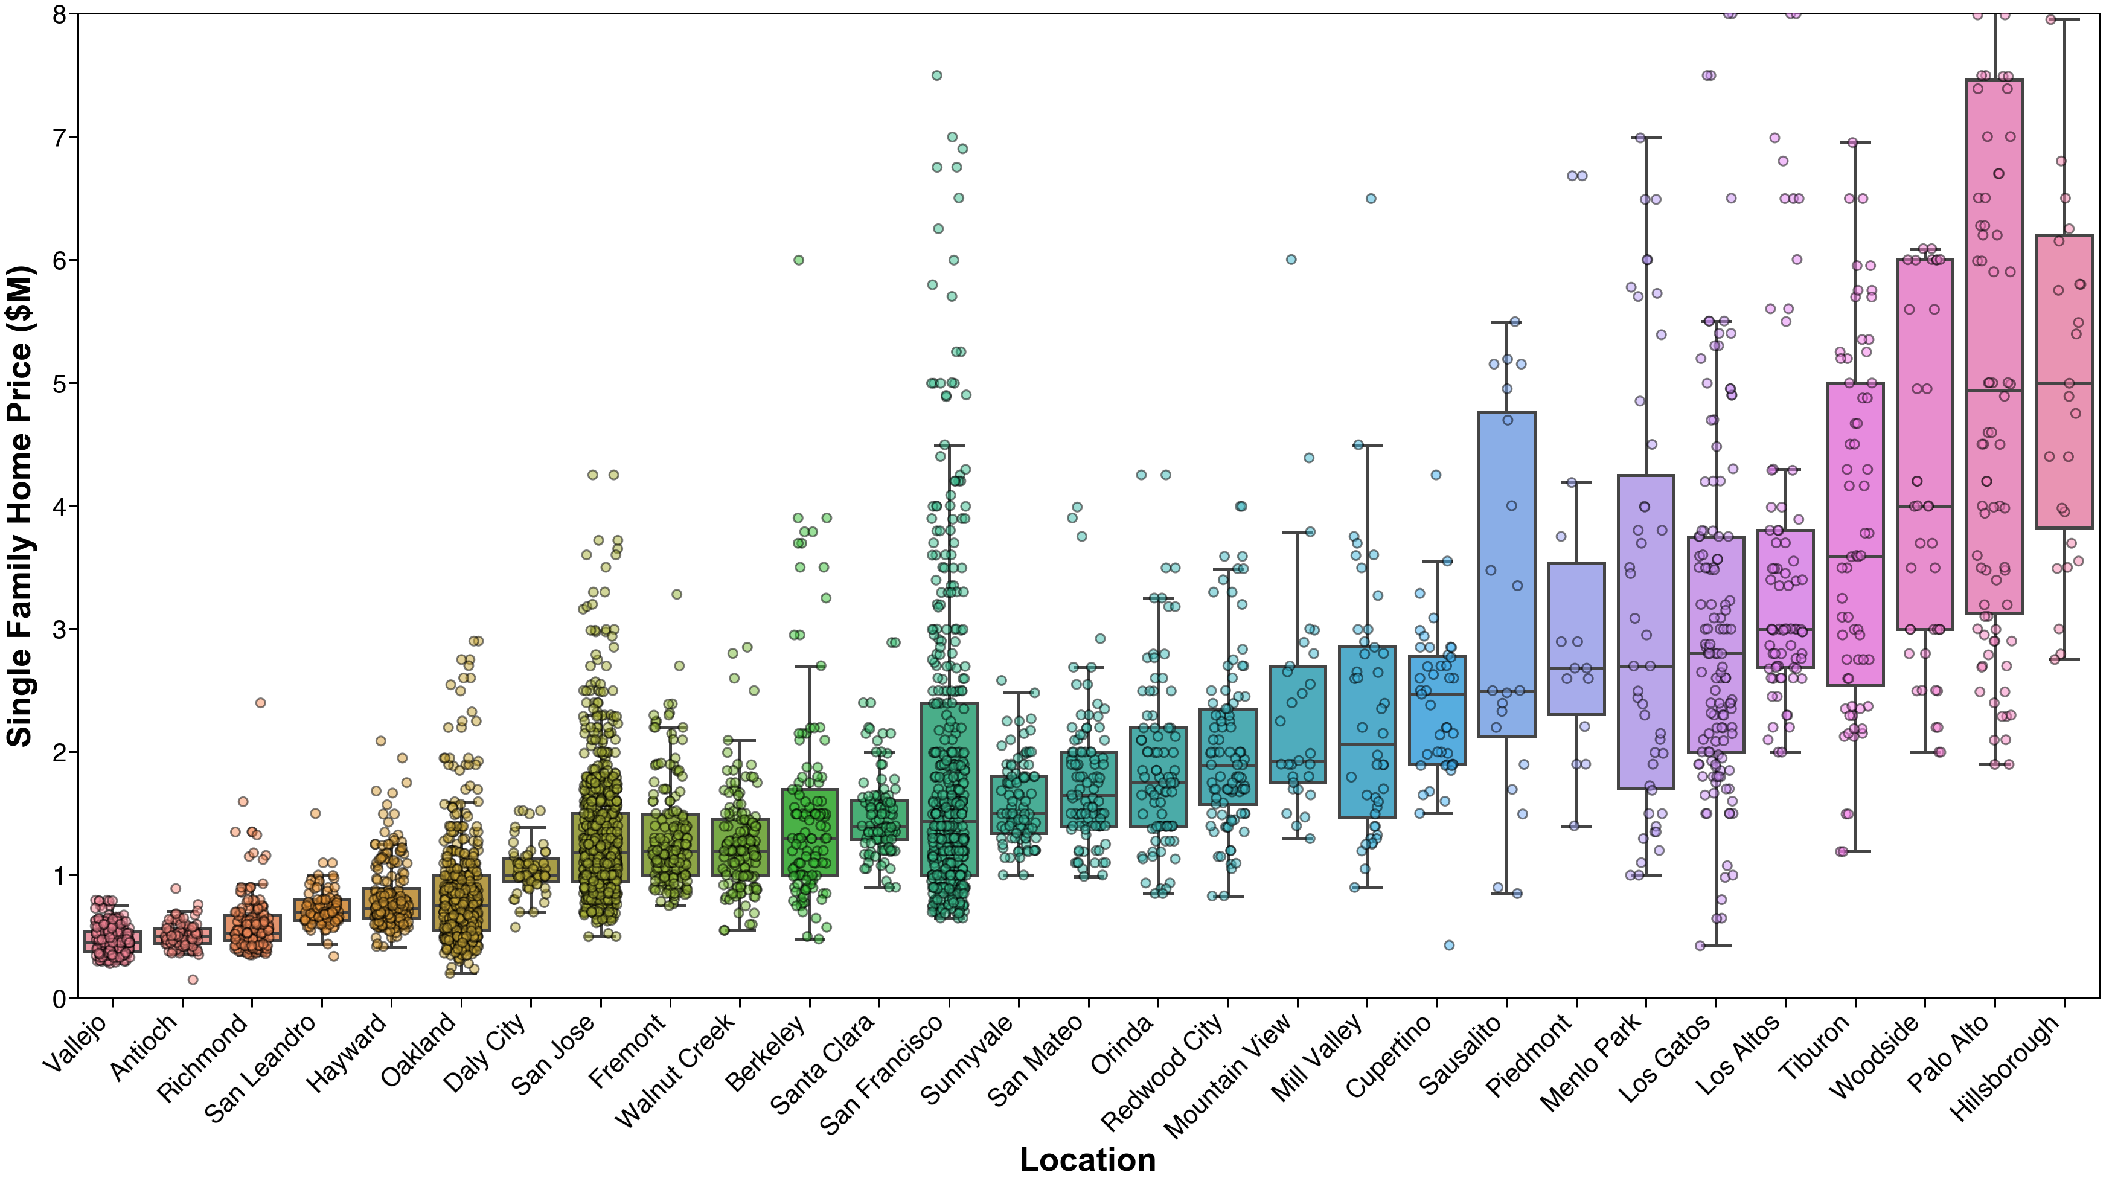
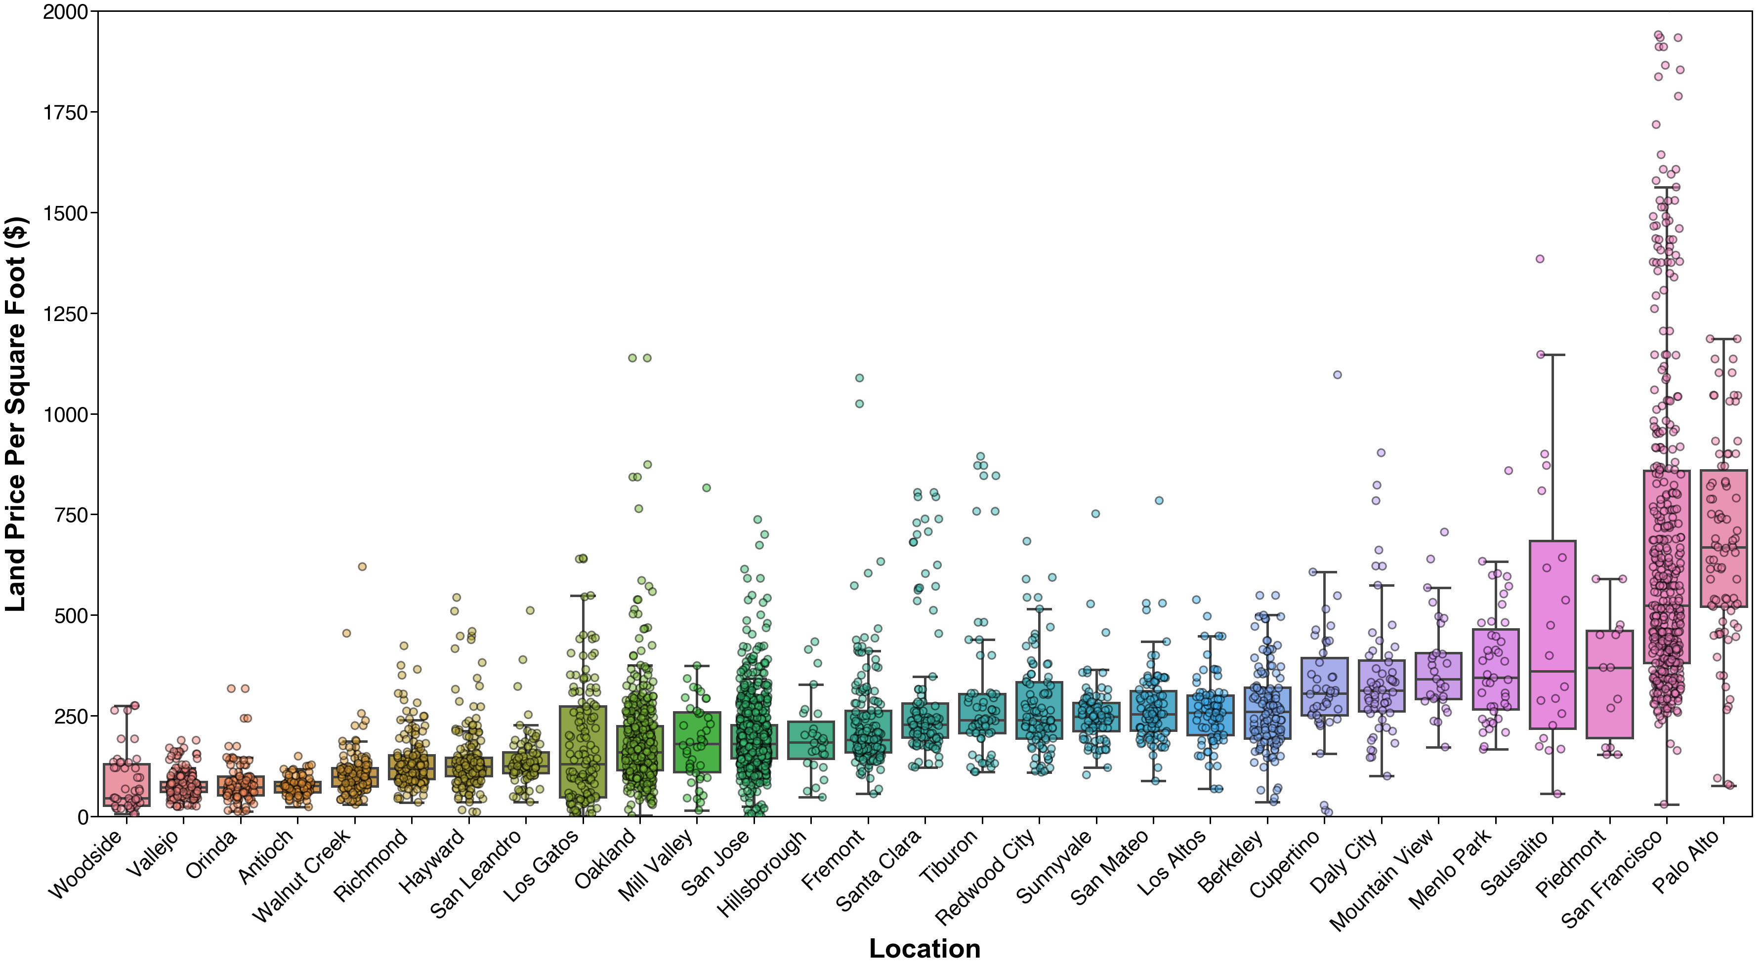
Vallejo
Antioch
Richmond
Mill Valley
Tiburon
Walnut Creek
Sausalito
Berkeley
Orinda
Piedmont
Oakland
San Francisco
San Leandro
Daly City
Hayward
Hillsborough
San Mateo
Redwood City
Menlo Park
Fremont
Woodside
Palo Alto
Mountain View
Los Altos
Sunnyvale
Santa Clara
San Jose

